Slide 1

FinalEscape

Slide 2


Key Story Points
Depression
Use of video games as escapism
Dangers of overindulgence

Slide 3

Gameplay
Two different distinct game worlds. “RealWorld” and “GameWorld”.
An 2d adventure game with rogue-lite systems.
Gameplay only takes place in the “GameWorld”

Slide 4


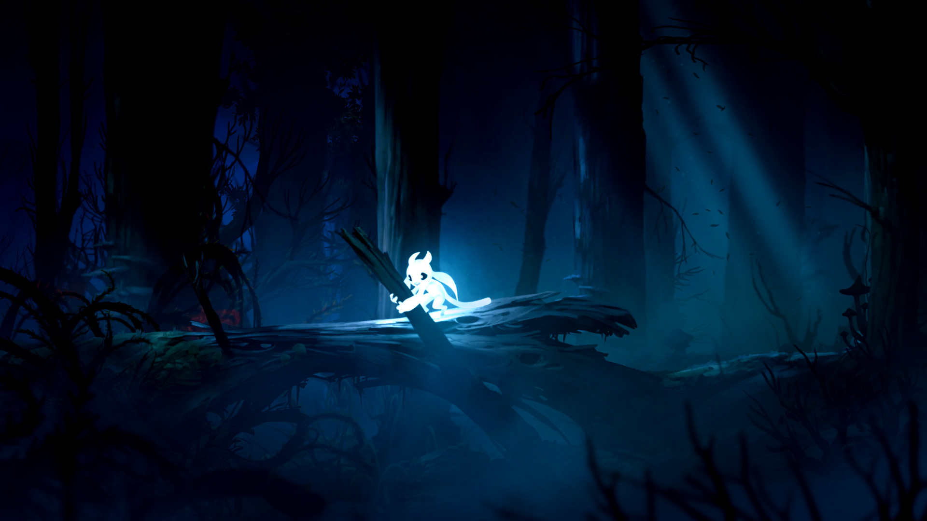
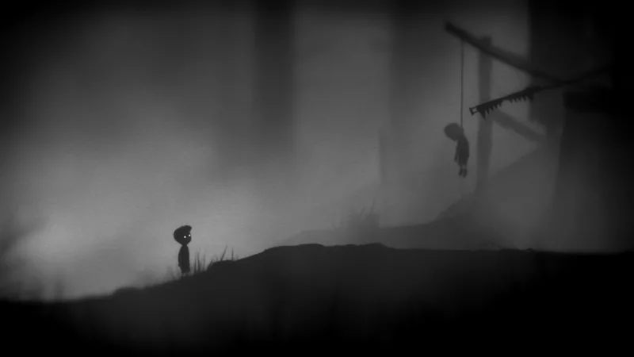
“RealWorld” Inspiration

Slide 5

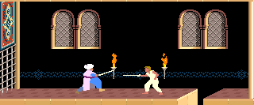

“GameWorld” Inspiration

Slide 6

Visual Story Telling
Through the game the “RealWorld” will change to represent the boys view of his surroundings.
The “GameWorld” also undergoes changes as the games story progresses.

Slide 7

Why Cheddar Cat?
Cheddar Cat is a small studio
FinalEscape will play to the studios creative strength
Inspired by one of the company's key values

